Slide 1

Introduction To Microservices
Pravinkumar R .D.

Slide 2
Agenda
Different architectures discussion
Monolithic Services Vs Microservices
Let’s discuss some scenarios
Limitations
Introduction to DDD – [Domain Driven Design]
Introduction to CQRS Pattern [Command Query Responsibility Segregation Pattern]
Introduction to Saga and Kafka

Slide 3
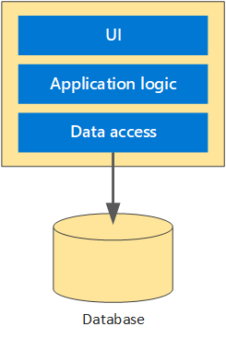
Layered Architecture

Slide 4
Layered Architecture
The application is divided into separate layers
Each Layer will have its specific responsibility
Presentation/UI Layer –
Involves user interaction and its responsibilities
Business Logic
Business rules, use cases, data transformation, domain models with relationships
Advantages –
Centralization of this layer can help to change business rules/processes at one place making it consistent and reducing the errors

Slide 5
Layered Architecture
Data Access Layer [DAL] –
Manage database connections
Implementation of CRUD operations
Data mapping [ORM]
Transaction Management

Slide 6
Disadvantages of Layered Architecture
Top-To-Bottom Communication approach
Presentation layer calls Business Logic layer, which in turn calls Data Access layer
Tight coupling
Layers can become tightly coupled, making changes harder
Performance –
Performance overhead due to multiple layers of abstraction

Slide 7
What if DAL changes?
It can have several implications for the business logic layer and the overall application
Interface inconsistency
Data model changes [New fields, different data types]
The business logic layer may need to be updated to handle these changes
For Example - How data is processed, validated, or transformed?
Any solution?
Yes!
Abstraction - Using interfaces or abstract classes to define the DAL
Dependency Injection - Implementing dependency injection helps DAL to change without impacting the Business Logic

Slide 8
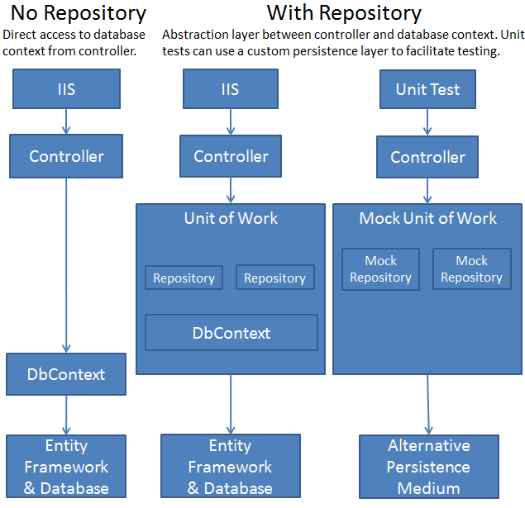
Layered Architecture with Dependency Injection

Slide 9
Repository Pattern and Dependency Injection
Repository Pattern –
Abstraction of data access logic
Swapping out data sources without affecting business logic
Advantages [Decoupling and Testability]–
Separates data access logic from business logic
Makes it easier to mock data access in unit tests
Disadvantages –
Complexity – extra layer of abstraction

Slide 10
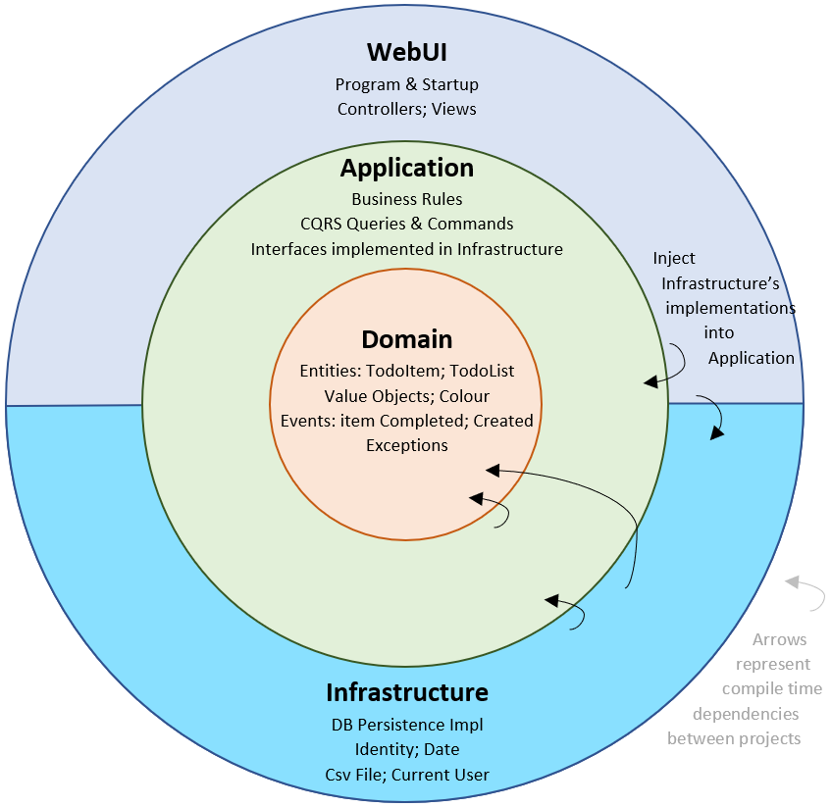
Clean Architecture

Slide 11
Clean Architecture
Proposed by Robert C. Martin (Uncle Bob)
It emphasizes keeping the core business logic and application logic at the center, with other layers (UI, database, etc.) depending on it
Advantages –
Independence – Core logic is independent of frameworks, UIs, DBs
Testability – highly testable due to clear separation of concerns
Maintainability - Easier to maintain and evolve over time

Slide 12
Clean Architecture
Disadvantages –
Complexity –
Can be complex to implement, especially for smaller projects
Learning Curve –
Requires a good understanding of architectural principles
When to use clean architecture?
Complex business logic
Large teams
Think about alternatives in case – Simple Services and Short-term projects

Slide 13
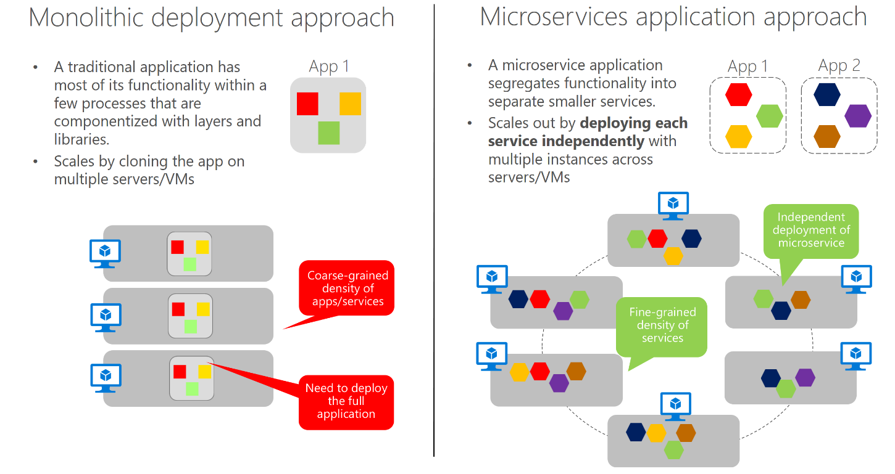
Monolithic Vs Microservices

Slide 14
Scenarios and Who is using?
Amazon –
Uses over 1000 microservices
For example – Order processing, Payments and Inventory Management
Netflix –
Uses over 700 microservices
For example - Including user recommendations, streaming, and account management
Uber, Airbnb, Spotify and many others –
Uber uses over 500 microservice

Slide 15
Benefits
Benefits –
Independent scaling, better handling of payloads
Flexibility –
Different microservices development using different technologies
Fault Isolation –
Failures in one service do not necessarily affect the entire system
Continuous Deployment –
Microservices can be deployed independently, enabling faster and more frequent updates
Teams can work independently

Slide 16
Limitations
Increased Complexity
Managing distributed system can be complex which always requires sophisticated orchestration and monitoring
Operational Overhead
Individual service deployment, monitoring and management leads to operational overhead
Data Management
Data consistency is management in distributed databases is challenging
Security, service discovery and other limitations

Slide 17
DDD – Domain Driven Design
A software development approach that focuses on modeling software to match a complex business domain
Popularized by Eric Evans in his book “Domain-Driven Design: Tackling Complexity in the Heart of Software.”
It includes number of parts –
Strategic Design
Tactical Design
Repositories and Services
Ubiquitous Language
Event Storming

Slide 18
DDD – Strategic Design
What is Strategic Design?
The high-level structure of the domain and how different parts of the system interact
Key Concepts –
Subdomains –
Specific areas in the large domain
For example – Ecommerce Application Domain –
Subdomains – Inventory Management, Order Management etc.

Slide 19
DDD – Strategic Design
Key Concepts –
Bounded Context –
Each subdomain is encapsulated within a bounded context, which defines clear boundaries where a particular model is applicable
This way, it ensures that different parts of the system do not interfere with each other
Example –
User Management Context
Inventory Management Context
Order Processing Context

Slide 20
DDD – Tactical Design
What is Tactical Design?
It is the detailed design within each bounded context which includes
Entities
Objects that have a distinct identity and lifecycle, such as a customer or an order
Value Objects
Objects that describe certain aspects of the domain and do not have a distinct identity, like an address or a date range
Aggregates –
A cluster of entities and value objects that are treated as a single unit for data changes
Aggregate Root –
The Aggregate Root is the main entity within an aggregate that acts as the entry point for accessing and modifying the aggregate

Slide 21
DDD – Repositories and Services
Repositories –
A bridge between domain model and data source
Provides methods to access and manipulate aggregates
Domain Services –
Used for implementing domain logic which is not a fit of any entity/value object
For example – Calculating the total payable amount for an order which needs to add different taxes and shipping charges

Slide 22
DDD - Ubiquitous Language
What is Ubiquitous Language?
A common language shared by all team members (developers, domain experts, etc.) to ensure clear communication
Helps in aligning the software model with business domain

Slide 23
DDD – Event Storming
Event Storming involves gathering all relevant stakeholders (developers, domain experts, business analysts, etc.) in a room to map out domain events using sticky notes
The goal is to create a shared understanding of the domain and identify key events, commands, and aggregates
For example –
Order Placed Event
Inventory Updated Event
Etc.

Slide 24
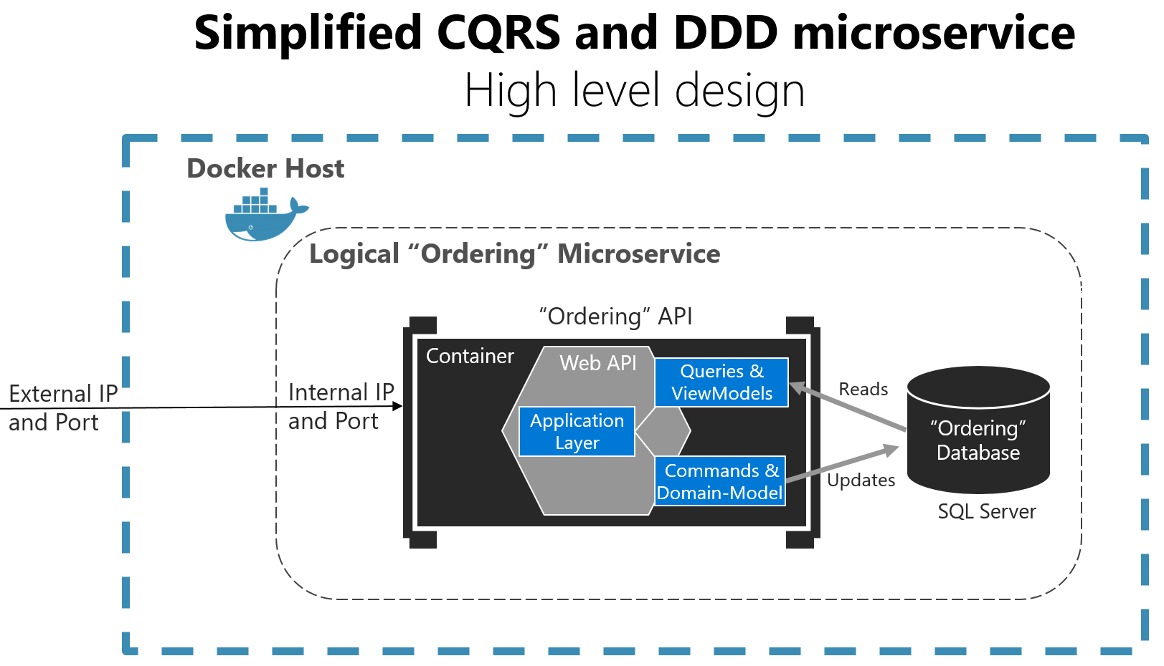
Command Query Responsibility Segregation Pattern

Slide 25
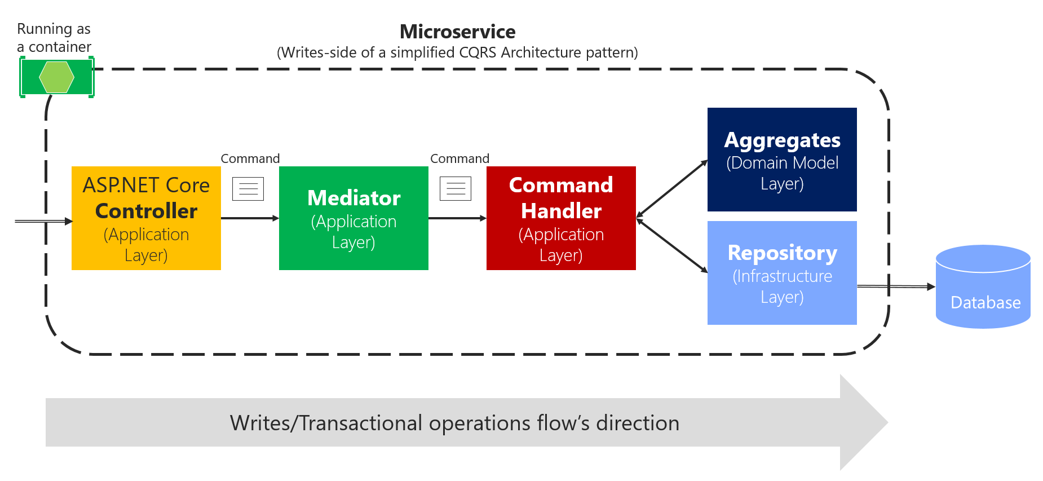
CQRS Write Operation with Mediator Pattern

Slide 26
Advantages of using CQRS
Improved performance and scalability –
By separating read and write operations, each can be optimized independently
Clearer separation of concerns –
Helps to implement clear separation of read and write operations
Flexibility in technology choice –
For example – Read operations on NoSQL and write operations on RDBMS servers
Enhanced maintainability and Testability

Slide 27
Disadvantages of CQRS
Increased Complexity –
Maintaining two separate models and keep them in sync is complex
Consistency Challenges –
In distributed systems, ensuring consistency for read and write operation is big challenge
Higher cost –
Require more resources for maintaining separate database for read/write operations
Expertise Requirement –
Need to be aware of various databases and patterns

Slide 28
Introduction to RabbitMQ
What is RabbitMQ?
RabbitMQ is an open-source message broker software that facilitates communication between different parts of a system by sending and receiving messages
It supports multiple messaging protocols and provides features like message queuing, delivery acknowledgments, and complex routing

Slide 29
When to use RabbitMQ?
Scenario –
Most widely used for traditional message queuing scenarios
Features offered –
Supports complex routing, message acknowledgments, and flexible message delivery guarantees
When to use –
When you need reliable message delivery with complex routing
For tasks like job scheduling, background processing, and decoupling microservices
Multiple messaging protocol and easy integration with various languages

Slide 30
RabbitMQ – What you need to know?
Producer –
Producers create messages and send them to an exchange
Exchange –
Exchanges receive messages from producers and route them to queues based on routing keys
Different Exchanges –
Direct exchange –
Routes messages with a specific routing key to the queue that has the same key
Topic exchange –
Routes messages to queues based on wildcard matches between the routing key and the queue binding

Slide 31
RabbitMQ – What you need to know?
Fanout exchange –
Routes messages to all queues bound to it, regardless of the routing key
Header exchange –
Routes messages based on header values instead of routing keys
Queues
Queues store messages until they are consumed by a consumer
Each message is delivered to one or more consumers
Consumer –
This is the application that receives messages from a queue and processes them

Slide 32
RabbitMQ – What you need to know?
Bindings –
Bindings are the relationships between exchanges and queues
They determine how messages are routed from an exchange to a queue
Management Plugin –
This web-based interface allows you to monitor and manage RabbitMQ, including viewing queues, exchanges, and connections

Slide 33
RabbitMQ – Workflow
Service A (Producer) --> Exchange --> Queue --> Service B (Consumer)
Service – A
This service generates a message when a specific event occurs
For example – New event added
It sends this message to RabbitMQ
Exchange –
The message first arrives at an exchange in RabbitMQ
The exchange determines how to route the message based
Direct, Topic, Fanout or Headers

Slide 34
RabbitMQ – Workflow
Routing –
The exchange uses routing keys or header values to route the message to the appropriate queue(s)
Queue –
The message is stored in a queue until it is consumed
Queues can be configured to handle different priorities, persistence, and other properties
Service B (Consumer) –
This service subscribes to the queue and processes messages as they arrive

Slide 35
RabbitMQ – Workflow
Acknowledgement –
Service B sends an acknowledgment back to RabbitMQ to confirm that the message has been processed
If the message processing fails, it can be requeued or sent to a dead-letter queue for further inspection
Scaling –
Multiple instances of Service B can consume messages from the same queue – Horizonal Scaling
RabbitMQ ensures that each message is delivered to only one consumer instance

Slide 36
Introduction to Saga Pattern
What is Saga Pattern?
The Saga pattern is a design pattern used to manage distributed transactions in microservices
Instead of using a single transaction that spans multiple services –
A saga breaks the transaction into a series of smaller and independent steps
Each step has a corresponding compensating action to undo the work if a step fails
Which ensures data consistency across services

Slide 37
When to use Saga Pattern?
Scenario –
Managing distributed transactions across multiple microservices
Features –
Ensures data consistency and rollback capabilities through compensating transactions
When to use –
When you have long-running business transactions that span multiple services

Slide 38
Introduction to Kafka
What is Kafka?
Apache Kafka is an open-source distributed event streaming platform
It is designed for high-throughput, low-latency data streaming and real-time data processing
Kafka is used to build real-time data pipelines and streaming applications –
Message retention
Replay, and in-order message processing within partitions

Slide 39
When to use Kafka?
Scenario –
High-throughput, real-time data streaming and event sourcing
Features –
Distributed streaming platform, supports high message throughput, and guarantees in-order message processing within partitions
When to use –
When you need to process large volumes of data in real-time
For event-driven architectures and log aggregation
High throughput data streams, message retention and reply capability

